Slide 1
The Truth about Persecution
4 Views – Based on Matthew 13
James D. (Jim) Cunningham
© 2016

Slide 2

The Truth about Persecution
The Optimist
“It could never happen here”

Slide 3
The Optimist
The Truth about Persecution falls ‘beside the road’ – and the birds eat the seed: the Evil One comes and snatches away the seed.
The Optimist wants to ‘feel good’ about the Good News of Jesus Christ but feels confused and
‘misunderstands’ the Truth about Persecution.

Slide 4

The Truth about Persecution
The Pragmatist
“It doesn’t happen anymore.”

Slide 5
The Pragmatist
The Truth about Persecution falls ‘in rocky places’ – and in the dry soil it sprouts and withers: a temporary reasoned approach without a firm rooting.
The Pragmatist wants to ‘stand strong’ when the storms of persecution come but falls away and
‘denies’ the Truth about Persecution.

Slide 6
The Truth about Persecution
The Hedonist
“No time to think about it”

Slide 7
The Hedonist
The Truth about Persecution falls ‘among thorns’ – and the thorns choke out the seed: the worries of this world and the deceitfulness of riches.
The Hedonist desires to ‘give it all to Jesus’ and avoid the deceit of materialism but gives up and
‘chokes’ the Truth about Persecution.

Slide 8

The Truth about Persecution
The Realist
“Keeps watch because we do not know the day or hour it comes”

Slide 9
The Realist
The Truth about Persecution falls ‘on good soil’ – and yields an abundant crop: phenomenal spiritual growth and good preparation to ‘stand strong through the storm’.
The Realist wants to have the Holy Spirit live within their heart, mind and soul to hear, understand and
‘applies’ the Truth about Persecution.

Slide 10
The Truth about Persecution
Brother Andrew says:
“I have heard only two responses from Christians:
Those who said:
‘It will never happen here…’
…and those who said:
‘We thought it would never happen here.’ ”

Slide 11
PROCESS OF CHRISTIANITY IN CANADA
Before 1890 - Foundational
In the 1890’s - Significant
In the 1900’s - Influential
In the 1960’s - Accepted
In the 1980’s - Tolerated
In the 1990’s - Marginalized
In the 2000’s - Persecuted
Bob Kuhn…Christian lawyer + President of Trinity Western University

Slide 12
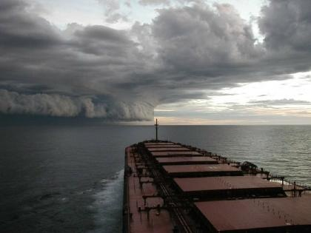
Four Coming Storms
(Luke 6:22)
1. Storm attacking our Faith
HATE us for what we ‘Believe’
Secular Humanism
Political Correctness
Will affect employment

Slide 13
Four Coming Storms
(Luke 6:22)
2. Storm attacking the Bible
EXCLUDE us for what we ‘Say’
Gay agenda
Same Sex Marriage
Hate Literature and Hate Laws
Use of Bible Restricted

Slide 14
Four Coming Storms
(Luke 6:22)
3. Storm attacking Evangelism
INSULT us for what we ‘Do’
Multiculturalism
Pluralism - Syncretism
Anti-conversion laws

Slide 15
Four Coming Storms
(Luke 6:22)
4. Storm attacking the Church
REJECT us for who we ‘Are’
Exclusivists - “Intolerant”
Limitations on tax laws
Remove Charitable Status
Imprisonment for ‘breaking’ laws

Slide 16
Four Coming Storms
(Luke 6:22)
1. Storm attacking our Faith
HATE us for what we ‘Believe’
Secular Humanism
Political Correctness
Will affect employment
2. Storm attacking the Bible
EXCLUDE us for what we ‘Say’
Gay agenda
Same Sex Marriage
Hate Literature and Hate Laws
Use of Bible Restricted
3. Storm attacking Evangelism
INSULT us for what we ‘Do’
Multiculturalism
Pluralism - Syncretism
Anti-conversion laws
4. Storm attacking the Church
REJECT us for who we ‘Are’
Exclusivists - “Intolerant”
Limitations on tax laws
Remove Charitable Status
Imprisonment for ‘breaking’ laws

Slide 17
5 Primary Sources of Persecution
3. Religious Leaders
3. Our Day
2. Disciples Day
1. Jesus’ Day
2. Jews
Rulers
(Authorities)
Relatives
(Family)
1. Scribes
Pharisees
Caesar/Romans
Community
Pilate/
Romans
Jesus
Brothers
Pig Farmers
Crucify Him
Silversmiths
Mobs
Rich Guys
Rowdies

Slide 18
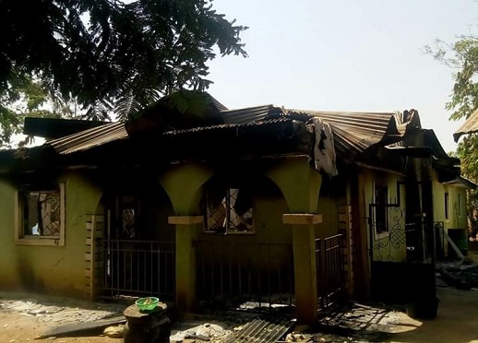
45 killed yesterday in another attack on Christian communities in Kaduna, Nigeria

Slide 19
The Communist Manifesto
Abolition of private property.
Abolition of the family!
Abolition of borders and nationalities (Globalism)
Abolition of all religion and “eternal truths.”
Abolition of all right of inheritance.
Centralization of banks, capital, communication and transportation (State-controlled).
Free Education & obligation of all to work!

Slide 20
Attack on the Family
The Enemy’s pressure on our children and grand-children:
Lose virginity – before marriage
Experiment with (and/or accept) LGBTQ Lifestyle
Delay Marriage (China: must be 25)
Voluntarily choose to have NO children
Or have only 1 or 2 children (vs Islam 4 wives + 23 children!)
Betray vows – Commit adultery – Be abusive
Give in – Give up – get a divorce – or 2 – or more
Get a STD – Sleep with the dog!
Work long hours – Make MORE money!
Forget God – Skip Church – No Bible Study or Prayer.

Slide 24



1967
Ohhh Canada
2017
GOD OR MAMMON?
National Debt
$0.00
National Debt
$1 Trillion+
78 % of Canadians filing T1’s claim NONE of their Income given to Charity/Church/Mission (2009)
22 % of Canadians filing T1’s claim SOME “Charitable Giving” from income (MEDIAN = $250.00)
See: Leviticus 26:32-35; 2 Chronicles 36:21; Jeremiah 29:10-13 – and then Malachi 3:8-12; 2 Corinthians 9:6-15 & 1 Timothy 6:6-10
jdcunningham@telus.net

Slide 25
Clashing Cultures
1989 – met “Fanny & Charlie” in China. Lived in same tiny “Flat” for 57 years – raised 4 sons. Survived deep persecution for their faith in Jesus Christ. Sign on their LR wall said: “CHRIST is the HEAD of this HOUSE.”
2000 – met son “Paul.” He inherited/upgraded Flat with A/C, fridge, stove, WC etc. Asked 21-year-old son “Jimmy” if he remembered sign: “I do not share my grandmother’s faith!”
1st Generation: Committed ‘Persecuted’ Christians
2nd Generation: Indifferent ‘Secular’ Materialists
3rd Generation: Active ‘Professing’ Agnostics

Slide 26
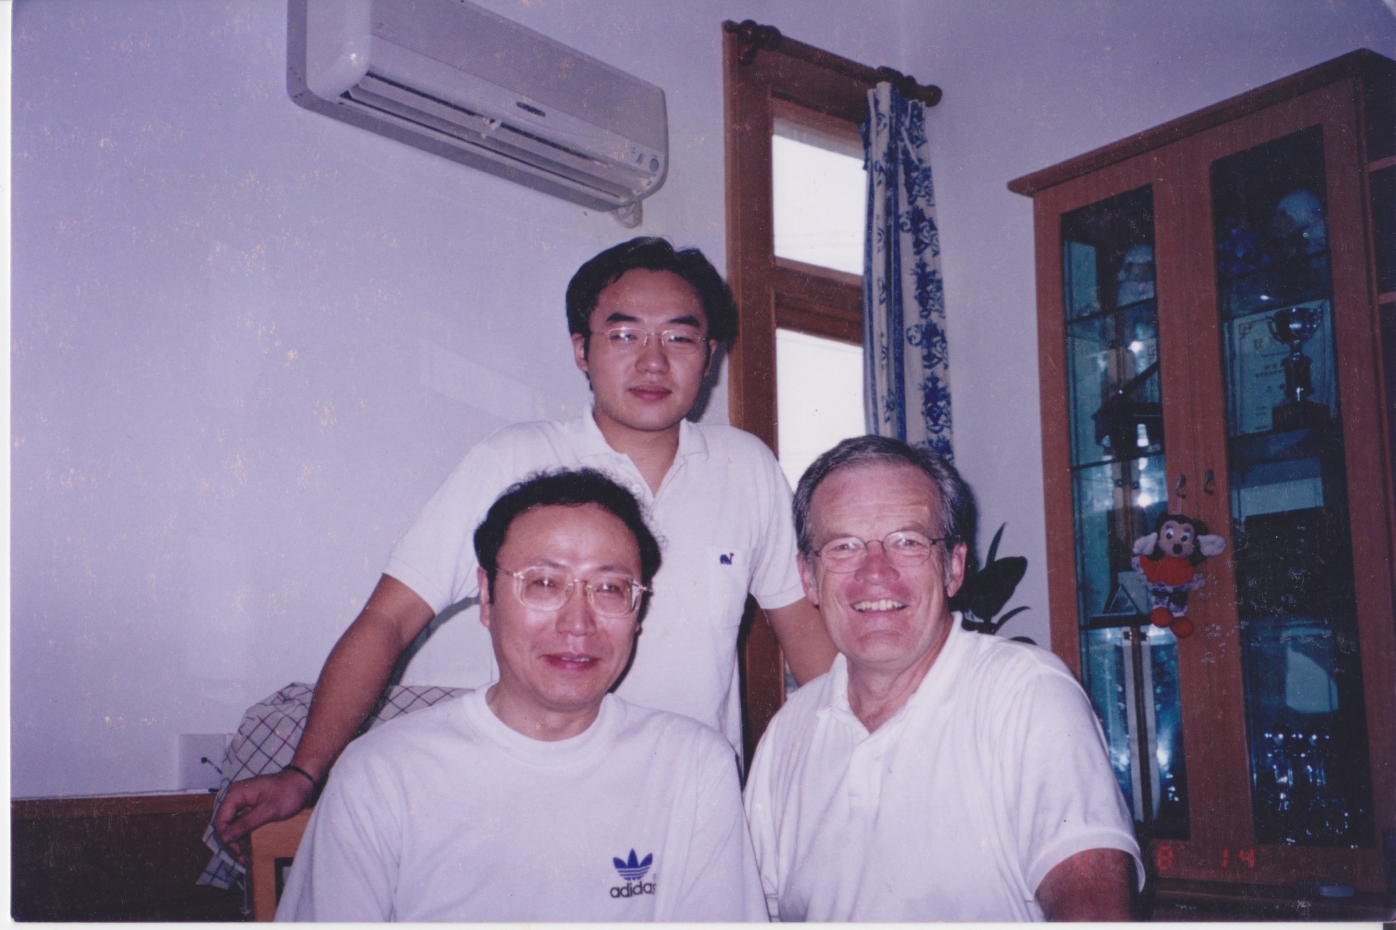
Pray for “Jimmy” – and Canada!

