Slide 1
A Peacemaker’s Response to Persecution
Dr. James D. (Jim) Cunningham
International Consultant in Adult Education with
Open Doors International / Wycliffe Bible Translators
24 October 2014

Slide 2
Peacemaking Principles Learned from
Persecuted Christians

Slide 3
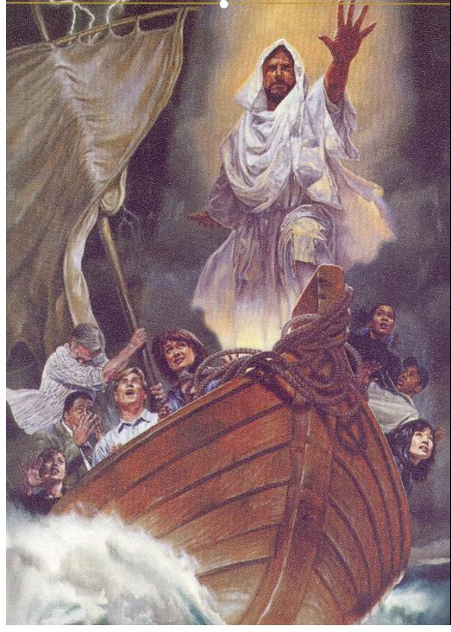
Principle 1
Be at peace in the midst of storms.
God is in control!
Mark 4:35-41;
Acts 27:25;
Revelation 14:12.

Slide 4
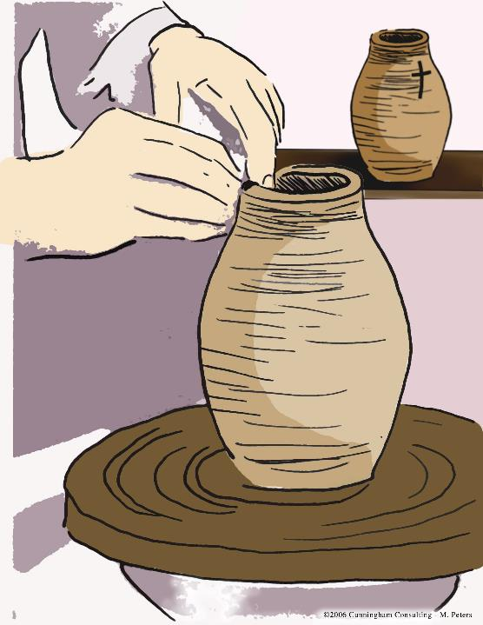
Principle 2
God’s ultimate goal,
whether by
persecution or
freedom,
is for us to be
conformed to the
image of His Son.
Hebrews 12:3-10;
Romans 8:29.

Slide 5
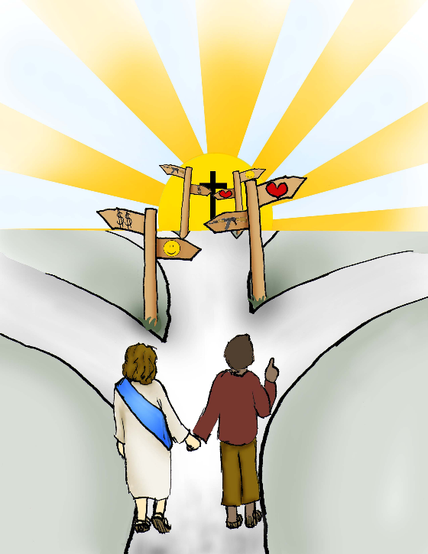
Principle 3
We keep our eyes
fixed on
Jesus Christ,
the Living God,
who modeled
perseverance
when confronted
with opposition
Hebrews 12:2

Slide 6
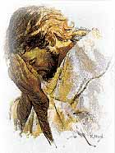
Principle 4
We follow a unique
leader: Jesus Christ
—fully man
and fully God,
who modeled
suffering servanthood.
Philippians 2:6-11;
Mark 10:42-45;
Isaiah 53:5.

Slide 7

Principle 5
Dying to self daily is God’s
way for us to live in the
power of the resurrection.
Matthew 16:24;
Galatians 2:20;
2 Corinthians 1:9.
(*)
Cannot
Fight
Cannot
Run
Away
Cannot
Argue
(*) Four Things You Cannot Do
While ‘Carrying A Cross’
Cannot
Worship
Idols

Slide 8
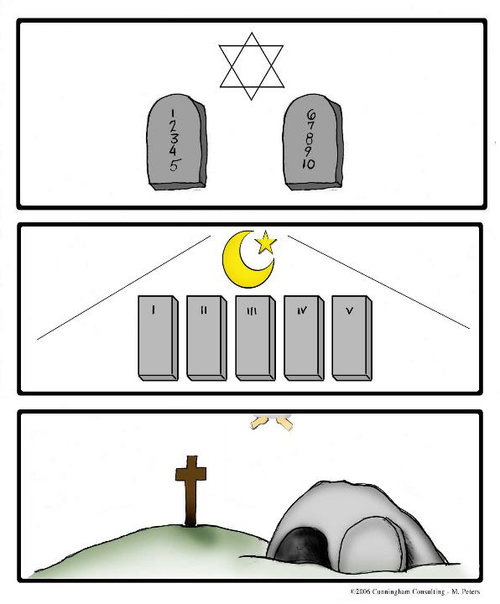
Principle 6
God builds His
kingdom not on our
achievements but on
our sacrifices
Mark 8:35;
Philippians 2:1-11.

Slide 9

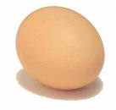
Principle 7
Living godly in Christ
Jesus will bring
persecution and sharing
in the sufferings of
Jesus
2 Timothy 3:12; 1 Peter
2:21-25; Daniel 6:21-23.
Are you like a Carrot?
An Egg? or Tea?

Slide 10
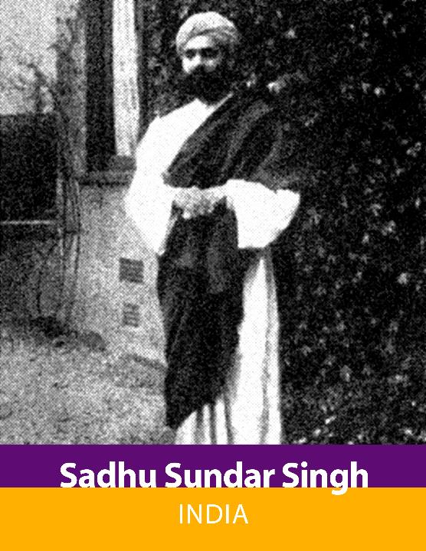
Principle 8
Suffering in the
will of God
always has
meaning and
purpose
2 Corinthians 11:23-30.

Slide 11
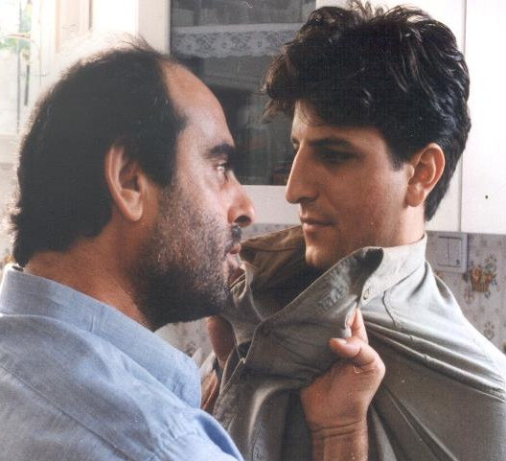
Principle 9
Accepting
persecution is the
secret of our victory
rather than the absence
of trouble or the
presence of
prosperity and
affluence.
1 Corinthians 4:11-13;
2 Corinthians 4:7-11.

Slide 12
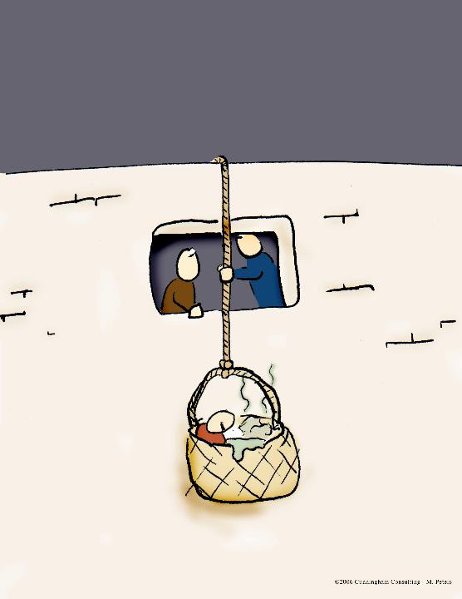
Principle 10
Fleeing from violence
requires
dependency on the
Holy Spirit
for guidance.
Matthew 10:23;
John 8:59;
Acts 9:23-30; 17:5-10.

Slide 13

Principle 11
Staying and enduring
requires dependency
on the Holy Spirit
for guidance.
Luke 22:41-52;
Acts 7:54-60; 12:1-4;
16:22-24.

Slide 14
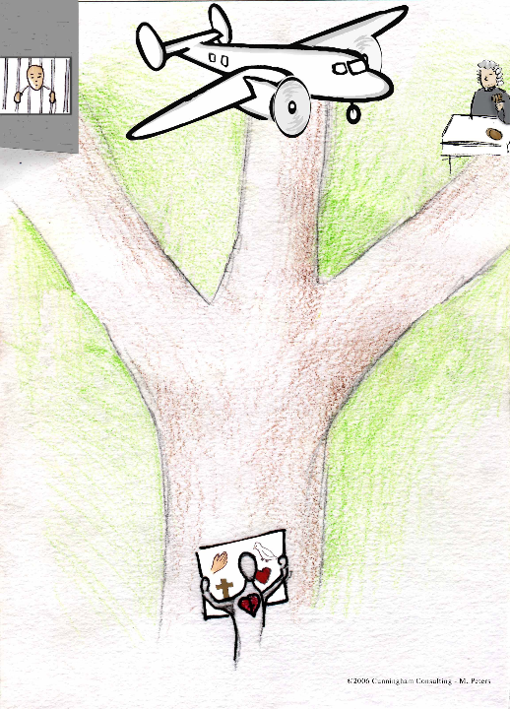
Principle 12
Appealing to legal
rights requires
dependency on the
Holy Spirit for
Guidance.
Acts 22:22-30;
25:10-11.

Slide 15
Principle 13
Overcoming evil with
good is our only
response for
vengeance belongs
to God
Deuteronomy 32:35;
Romans 12:19-21.

Slide 16
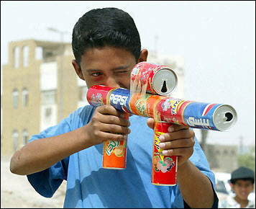
Principle 14
Victory is always
obtained by
faith keeping us
from being
defeated at the
hands of the
enemy
1 Peter 4:19.

Slide 17
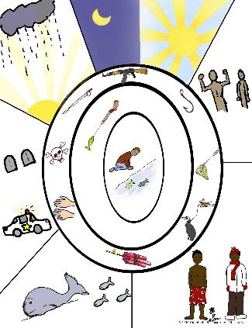
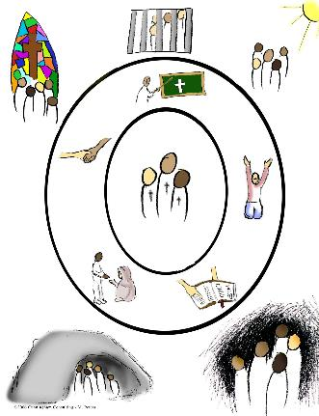
Principle 15
The Essence
And Functions
Of the church are defined;
Forms are
Optional.
Acts 2:41-47.

Slide 18
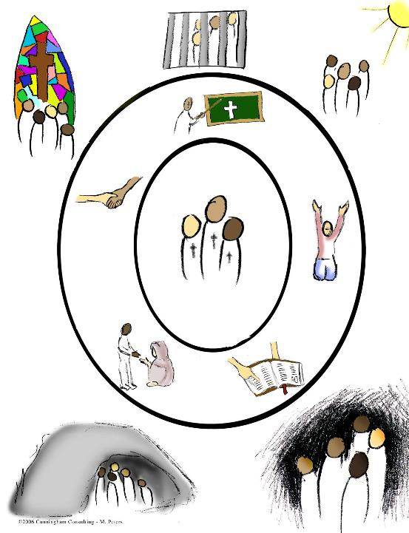
Principle 16
A biblical cell group
or house church will
fulfill all the
functions – including
evangelism
Matthew 28:19;
Acts 8:4; Acts 10.

Slide 19
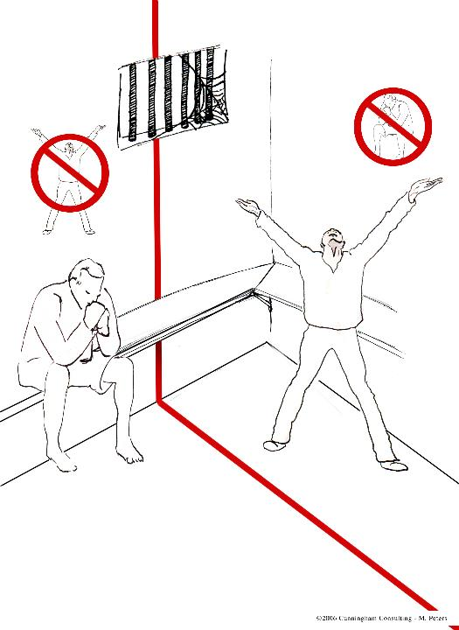
Principle 17
Rejecting someone
Because they do not
serve the Lord the
same way we do is
not an option
Luke 9:49-50;
Acts 10:34-35.

Slide 20
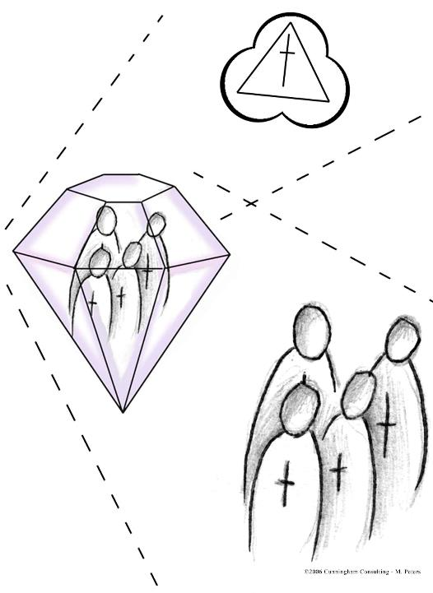
Principle 18
Strengthening the
family unit is
God’s design for
those “made in
His image”
Ephesians 5:21-27;
6:1-4.

Slide 21
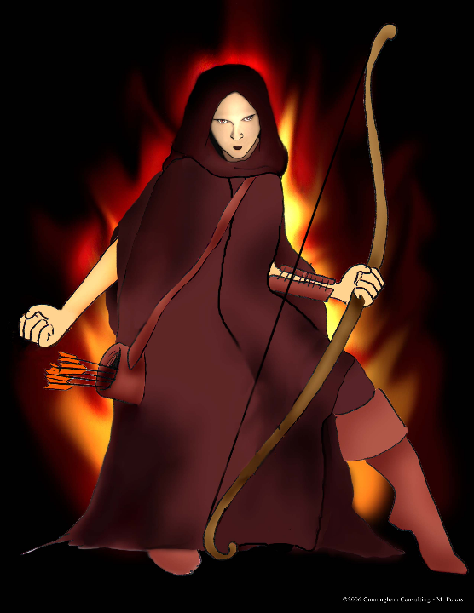
Principle 19
We have only one
Enemy,
Satan,
who uses a
variety of tactics
1 Peter 5:8.

Slide 22
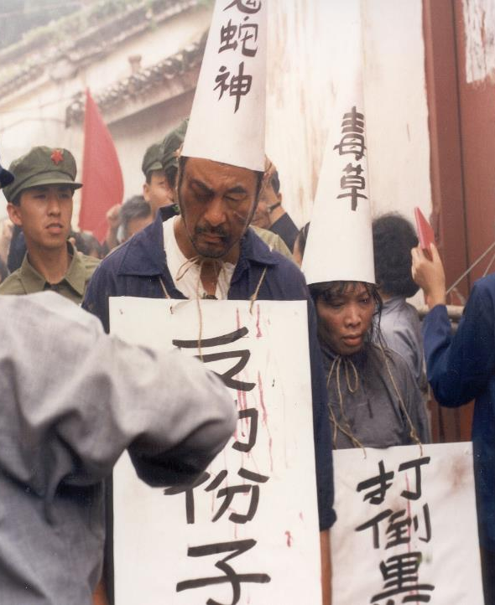
Principle 20
Satan’s goal is to
destroy, defeat
and discourage us
through deceit
and intimidation
John 8:44;
2 Corinthians 11:14-15;
Matthew 12:24.

Slide 23
Principle 21
Satan’s deadliest tactic,
pride, causes us to act
in Self-centeredness
with no need for God
Genesis 3:5b;
Luke 18:14;
1 Corinthians 4:6;
1 Peter 5:5.
How do you
‘Picture’
Pride?

Slide 24
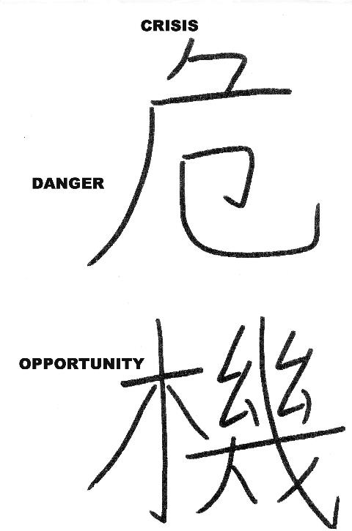
Principle 22
God is in control;
therefore, we do not
need to be afraid
even when facing
death
Psalm 27:1;
Luke 9:24;
2 Timothy 1:7;
Revelation 12:11.

Slide 25
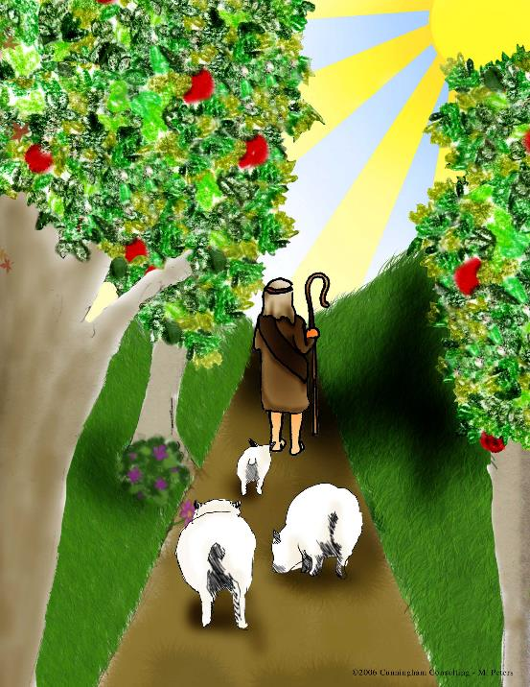
Principle 23
If we are filled with
the Holy Spirit and
have lost our fear of
death, we are
unstoppable until
God calls us home to
heaven
Matthew 10:28;
Luke 12:4-5.

Slide 26
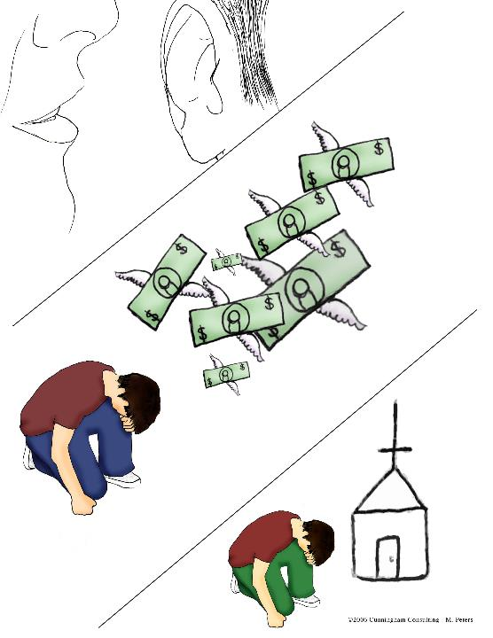
Principle 24
Choosing to
overcome slavery
to materialism is a
choice with
Eternal
consequences
Matthew 6:24;
Romans 6:16.

Slide 27
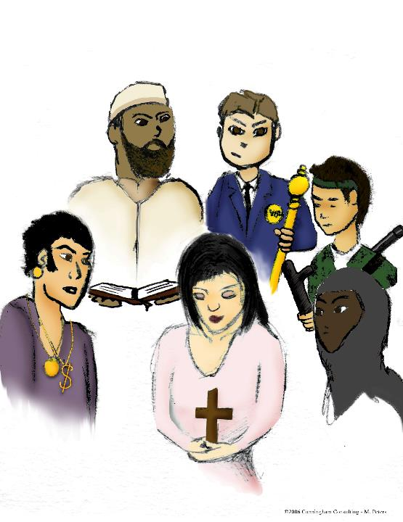
Principle 25
External tactics of
Satan come
at us through Rulers,
Religious leaders,
Rowdies, Rich Guys and
Relatives.
Acts 12:2, 8:1; 17:5; 19:23;
Matthew 10:35.

Slide 28
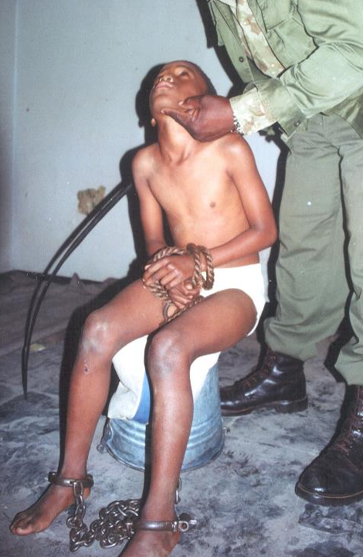
Principle 26
Satan’s external tactics include:
    O- Opposition,
    D- Disinformation,
    I - Injustice and
    M- Mistreatment
Hebrews 12:3; Matthew 5:11;
Acts 8:33a; Hebrews 13:3.

Slide 29
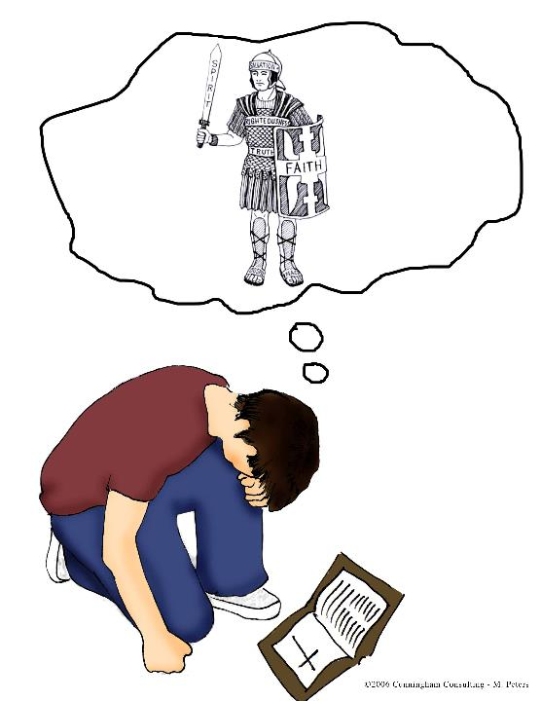
Principle 27
Being engaged in
a spiritual
battle, we use
only spiritual
weapons to wage
this warfare
2 Corinthians 10:3-6.

Slide 30
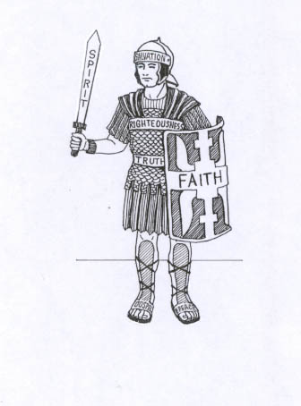
Principle 28
Wearing the full
armour of God
enables us to
stand strong
Ephesians 6:13.

Slide 31

Principle 29
Victorious Christians
live completely
under the control of
the Holy Spirit and
produce His
fruit in their lives.
Galatians 5:22-25.

Slide 32
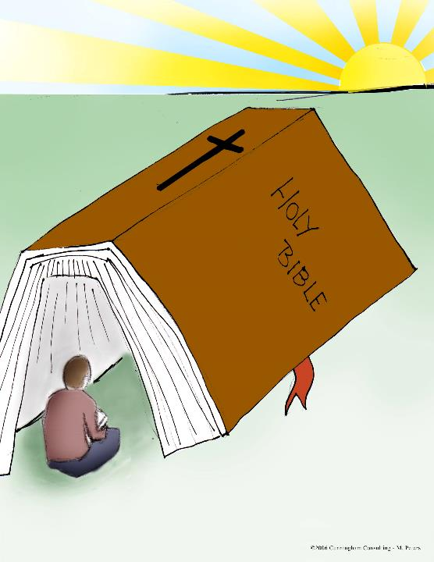
Principle 30
Knowing, internalizing
And obeying God’s Word
guarantees spiritual
Victory during the storms
Psalm 119:105;
Matthew 7:24-27;
John 6:63;
2 Timothy 3:16-17;
2 Peter 1:21

Slide 33
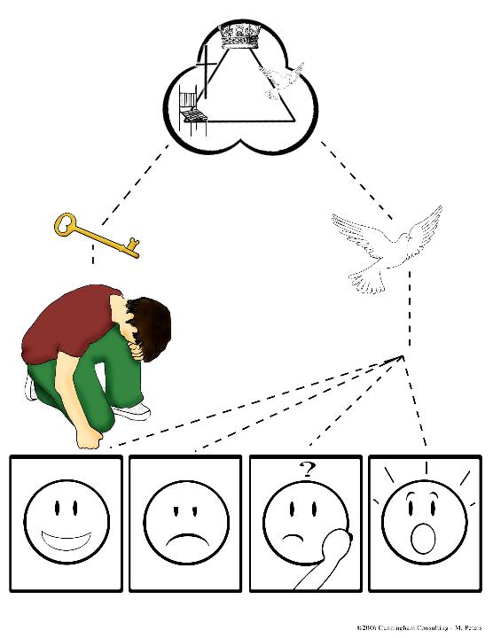
Principle 31
Learning to
persevere in prayer
increases our
guidance and
peace in difficult
times
Colossians 4:2;
Mark 11:24.

Slide 34
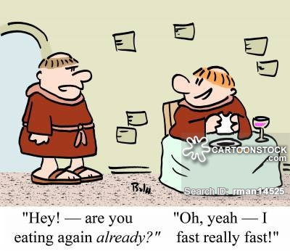
Principle 32
Fasting as an action
is modeled
for determining
God’s will.
Exodus 34:28;
Daniel 10:3;
Esther 4:16;
Acts 13:2-3; 14:23.
TBA

Slide 35
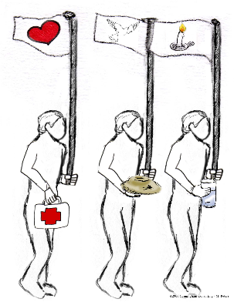
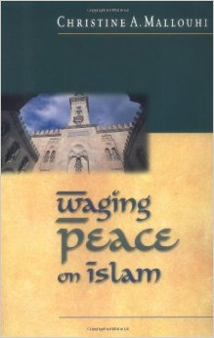
Principle 33
Approaching
conflict, we
“wage peace”
as ambassadors
of Jesus Christ
Matthew 5:9.

Slide 36
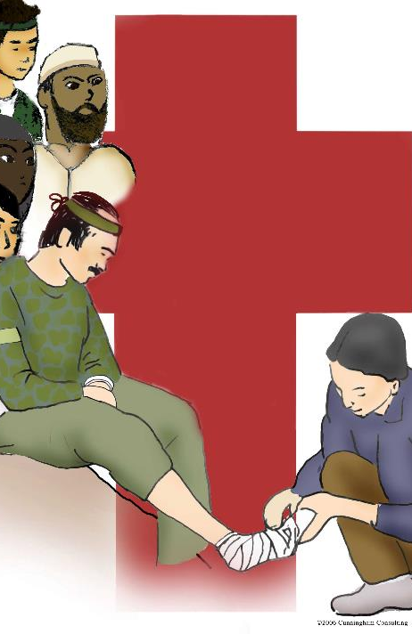
Principle 34
Agape love is
shown to
everyone and
even extends to
our enemies
John 13:35;
Luke 6:27.

Slide 37
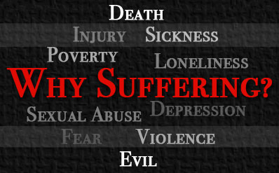
Principle 35
Suffering produces
perseverance which in
turn produces character,
hope, maturity and
completeness.
Romans 5:3;
James 1:4;
Hebrews 10:36.
TBA

Slide 38
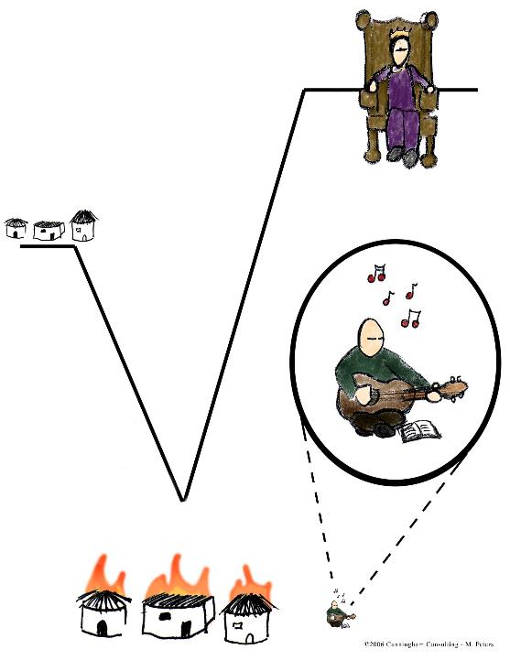
Principle 36
Learning to
encourage
ourselves in the
Lord, gives us
strength to persevere
when we are alone in
our spiritual battles
1 Samuel 30:6.

Slide 39
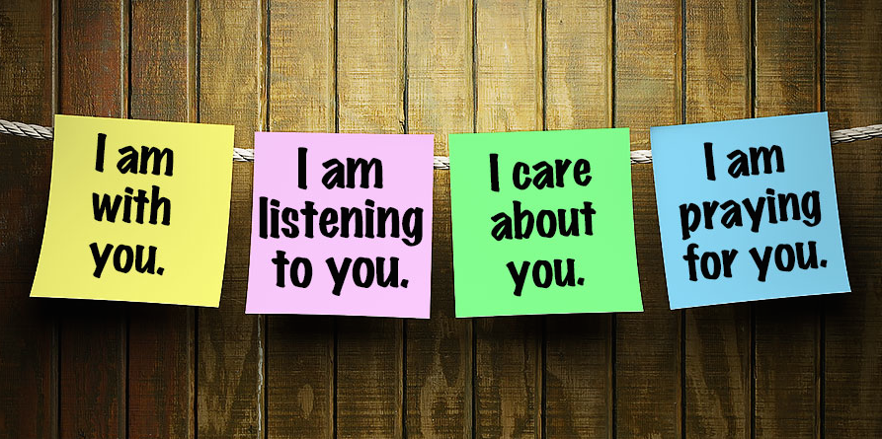
Principle 37
Encouraging one another
is a source of comfort to
those experiencing
difficulties
1 Thessalonians 5:11;
Hebrews 10:25.
TBA

Slide 40
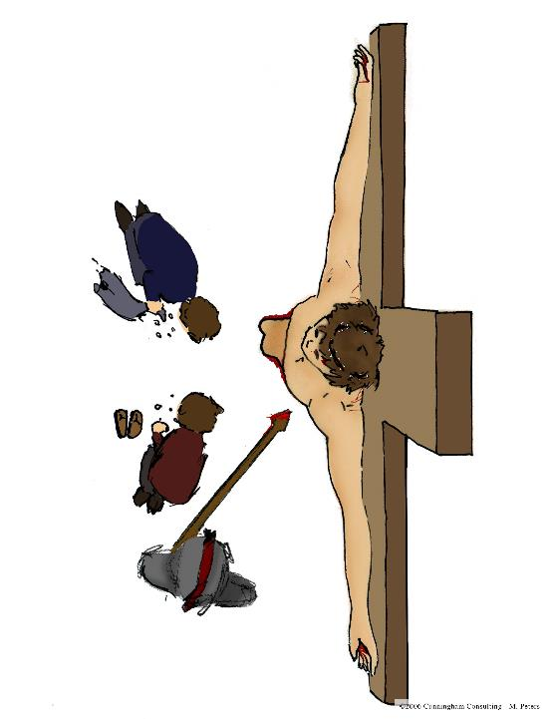
Principle 38
Forgiveness is a
command—not
an option—for
followers of
Jesus’ example
Luke 23:34;
Colossians 3:13.

Slide 41
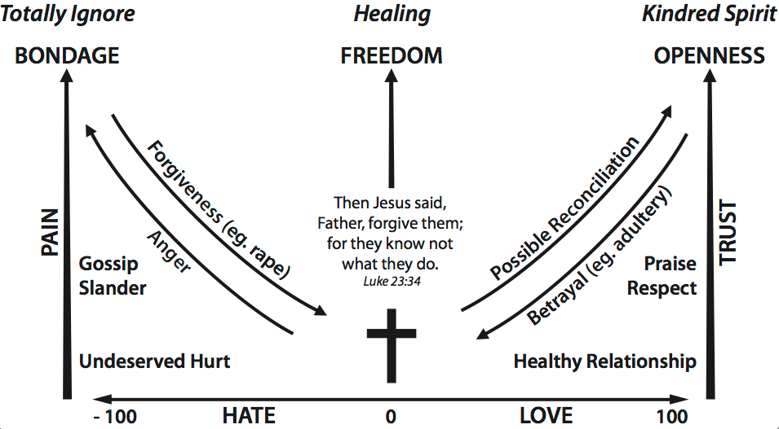
Principles 39
Choosing
forgiveness has
eternal
consequences
Matthew 6:14-15.

Slide 42
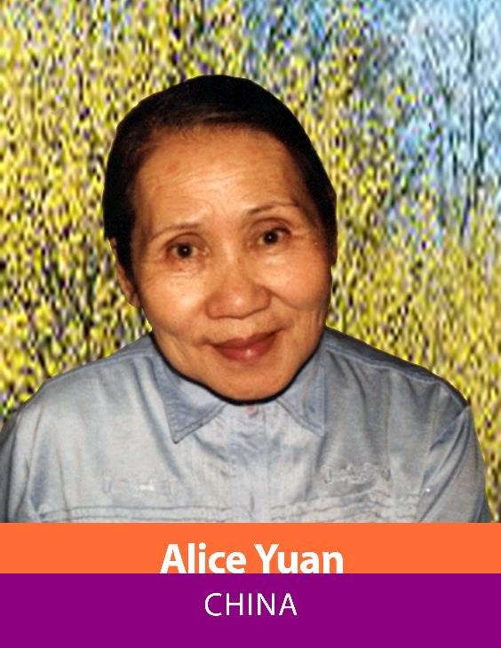
Principle 40
Showing grace
extends favour
or kindness to
one who neither
deserves it nor
can earn it
John 1:16.

